Slide 1
Chapter 2: Operating-System Structures

Slide 2
Chapter 2: Operating-System Structures
Operating System Services
User Operating System Interface
System Calls
Types of System Calls
System Programs
Operating System Design and Implementation
Operating System Structure
Virtual Machines
Operating System Debugging
Operating System Generation
System Boot

Slide 3
Objectives
To describe the services an operating system provides to users, processes, and other systems
To discuss the various ways of structuring an operating system
To explain how operating systems are installed and customized and how they boot

Slide 4
Operating System Services
Operating systems provide an environment for execution of programs and services to programs and users
One set of operating-system services provides functions that are helpful to the user:
User interface - Almost all operating systems have a user interface (UI).
Varies between Command-Line (CLI), Graphics User Interface (GUI), Batch
Program execution - The system must be able to load a program into memory and to run that program, end execution, either normally or abnormally (indicating error)
I/O operations - A running program may require I/O, which may involve a file or an I/O device
File-system manipulation - The file system is of particular interest. Programs need to read and write files and directories, create and delete them, search them, list file Information, permission management.

Slide 5
Operating System Services (Cont.)
Communications – Processes may exchange information, on the same computer or between computers over a network
Communications may be via shared memory or through message passing (packets moved by the OS)
Error detection – OS needs to be constantly aware of possible errors
May occur in the CPU and memory hardware, in I/O devices, in user program
For each type of error, OS should take the appropriate action to ensure correct and consistent computing
Debugging facilities can greatly enhance the user’s and programmer’s abilities to efficiently use the system

Slide 6
Operating System Services (Cont.)
Another set of OS functions exists for ensuring the efficient operation of the system itself via resource sharing
Resource allocation - When multiple users or multiple jobs running concurrently, resources must be allocated to each of them
Many types of resources - Some (such as CPU cycles, main memory, and file storage) may have special allocation code, others (such as I/O devices) may have general request and release code
Accounting - To keep track of which users use how much and what kinds of computer resources
Protection and security - The owners of information stored in a multiuser or networked computer system may want to control use of that information, concurrent processes should not interfere with each other
Protection involves ensuring that all access to system resources is controlled
Security of the system from outsiders requires user authentication, extends to defending external I/O devices from invalid access attempts
If a system is to be protected and secure, precautions must be instituted throughout it. A chain is only as strong as its weakest link.

Slide 7
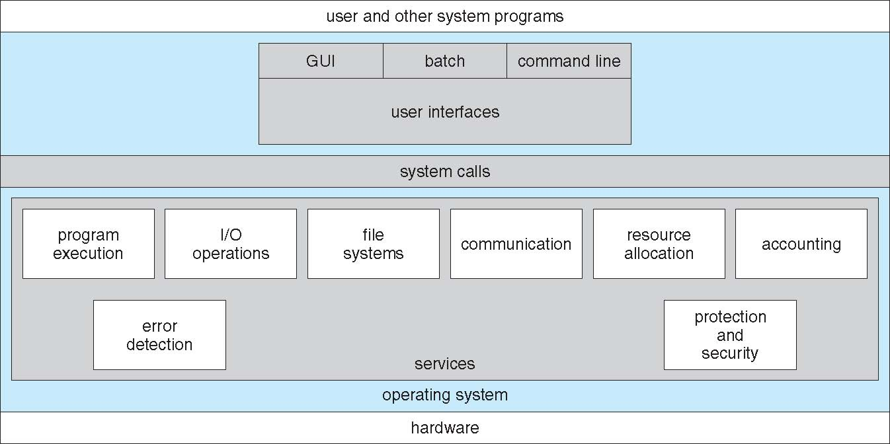
A View of Operating System Services

Slide 8
User Operating System Interface - CLI
Command Line Interface (CLI) or command interpreter allows direct command entry
Sometimes implemented in kernel, sometimes by systems program
Sometimes multiple flavors implemented – shells
Primarily fetches a command from user and executes it
Sometimes commands built-in, sometimes just names of programs
If the latter, adding new features doesn’t require shell modification

Slide 9
User Operating System Interface - GUI
User-friendly desktop metaphor interface
Usually mouse, keyboard, and monitor
Icons represent files, programs, actions, etc
Various mouse buttons over objects in the interface cause various actions (provide information, options, execute function, open directory (known as a folder)
Invented at Xerox PARC
Many systems now include both CLI and GUI interfaces
Microsoft Windows is GUI with CLI “command” shell
Apple Mac OS X as “Aqua” GUI interface with UNIX kernel underneath and shells available
Solaris is CLI with optional GUI interfaces (Java Desktop, KDE)

Slide 10
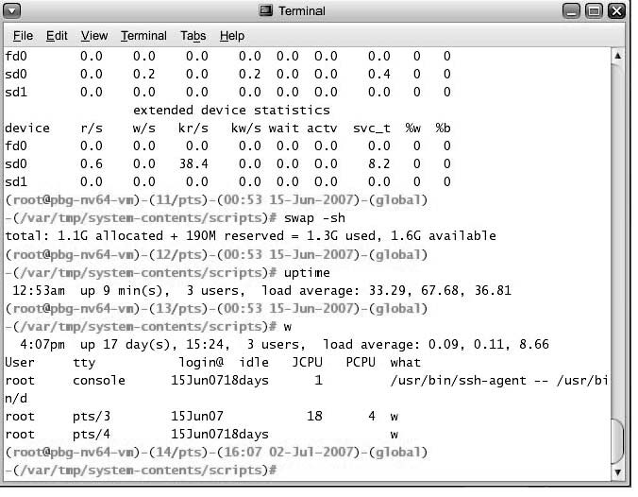
Bourne Shell Command Interpreter

Slide 11
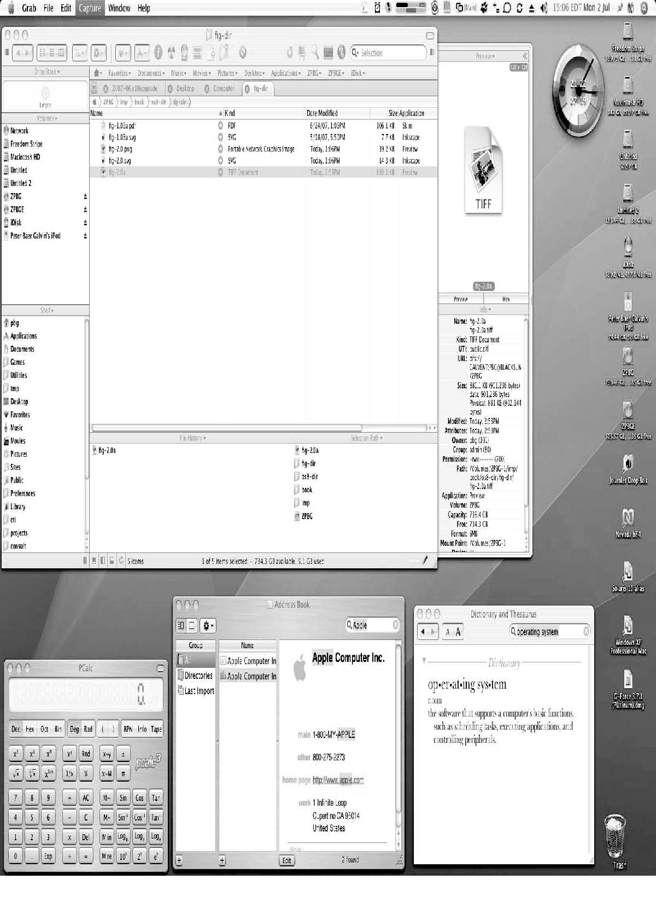
The Mac OS X GUI

Slide 12
System Calls
Programming interface to the services provided by the OS
Typically written in a high-level language (C or C++)
Mostly accessed by programs via a high-level Application Program Interface (API) rather than direct system call use
Three most common APIs are Win32 API for Windows, POSIX API for POSIX-based systems (including virtually all versions of UNIX, Linux, and Mac OS X), and Java API for the Java virtual machine (JVM)
Why use APIs rather than system calls?
(Note that the system-call names used throughout this text are generic)

Slide 13
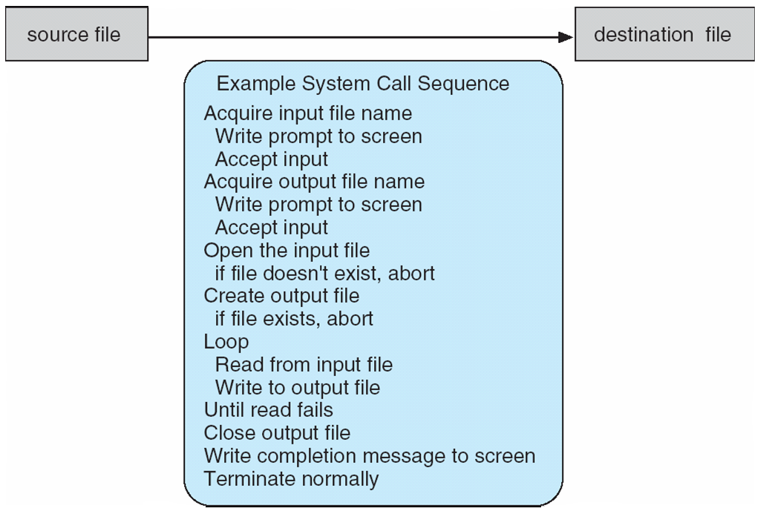
Example of System Calls
System call sequence to copy the contents of one file to another file

Slide 14
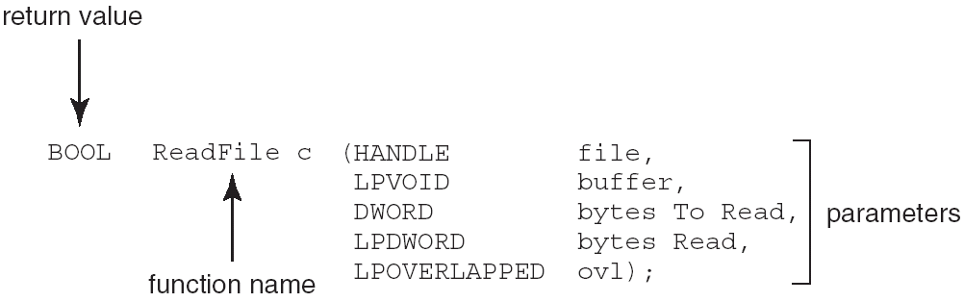
Example of Standard API
Consider the ReadFile() function in the
Win32 API—a function for reading from a file
A description of the parameters passed to ReadFile()
HANDLE file—the file to be read
LPVOID buffer—a buffer where the data will be read into and written from
DWORD bytesToRead—the number of bytes to be read into the buffer
LPDWORD bytesRead—the number of bytes read during the last read
LPOVERLAPPED ovl—indicates if overlapped I/O is being used

Slide 15
System Call Implementation
Typically, a number associated with each system call
System-call interface maintains a table indexed according to these numbers
The system call interface invokes intended system call in OS kernel and returns status of the system call and any return values
The caller need know nothing about how the system call is implemented
Just needs to obey API and understand what OS will do as a result call
Most details of OS interface hidden from programmer by API
Managed by run-time support library (set of functions built into libraries included with compiler)

Slide 16
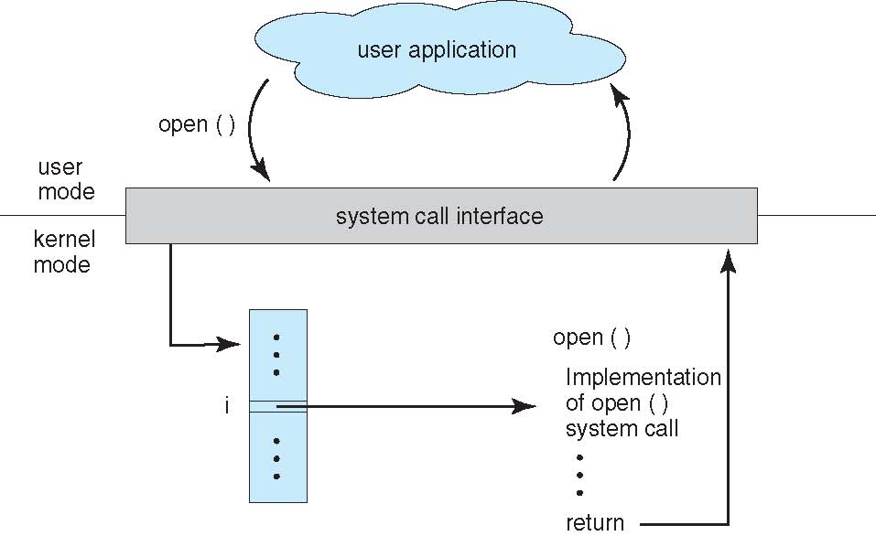
API – System Call – OS Relationship

Slide 17
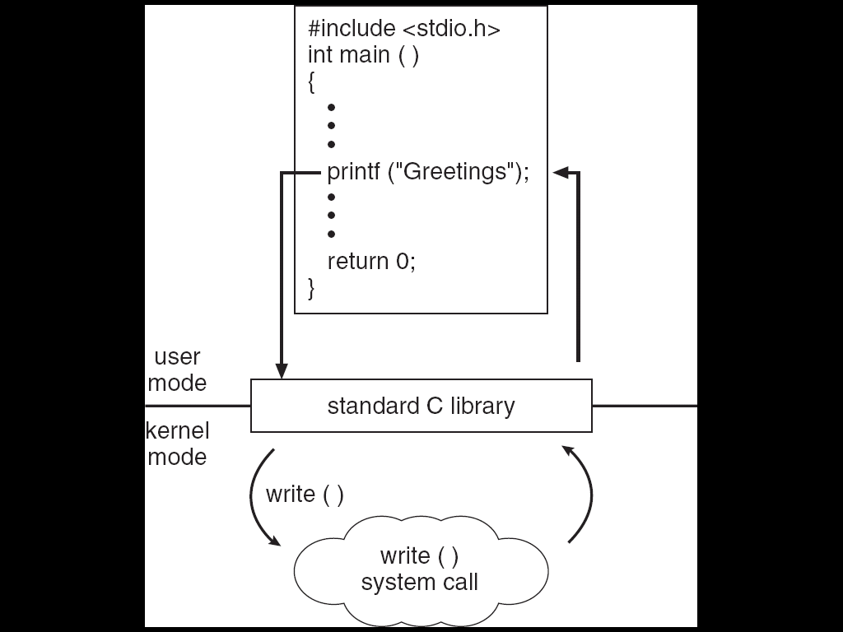
Standard C Library Example
C program invoking printf() library call, which calls write() system call

Slide 18
System Call Parameter Passing
Often, more information is required than simply identity of desired system call
Exact type and amount of information vary according to OS and call
Three general methods used to pass parameters to the OS
Simplest: pass the parameters in registers
In some cases, may be more parameters than registers
Parameters stored in a block, or table, in memory, and address of block passed as a parameter in a register
This approach taken by Linux and Solaris
Parameters placed, or pushed, onto the stack by the program and popped off the stack by the operating system
Block and stack methods do not limit the number or length of parameters being passed

Slide 19
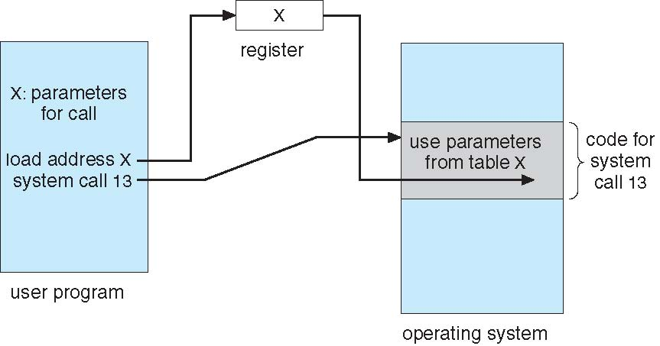
Parameter Passing via Table

Slide 20
Types of System Calls
Process control
end, abort
load, execute
create process, terminate process
get process attributes, set process attributes
wait for time
wait event, signal event
allocate and free memory
File management
create file, delete file
open, close file
read, write, reposition
get and set file attributes

Slide 21
Types of System Calls (Cont.)
Device management
request device, release device
read, write, reposition
get device attributes, set device attributes
logically attach or detach devices
Information maintenance
get time or date, set time or date
get system data, set system data
get and set process, file, or device attributes
Communications
create, delete communication connection
send, receive messages
transfer status information
attach and detach remote devices

Slide 22
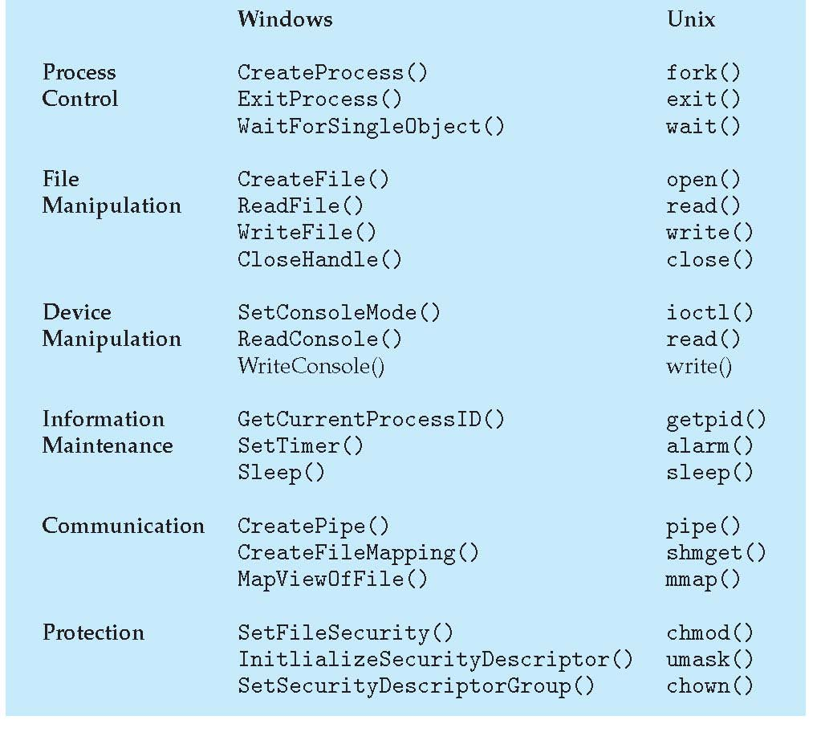
Examples of Windows and Unix System Calls

Slide 23
Example: MS-DOS
Single-tasking
Shell invoked when system booted
Simple method to run program
No process created
Single memory space
Loads program into memory, overwriting all but the kernel
Program exit -> shell reloaded

Slide 24
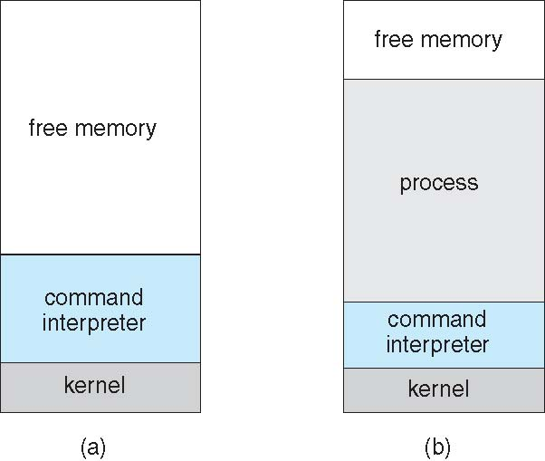
MS-DOS execution
(a) At system startup (b) running a program

Slide 25
Example: FreeBSD
Unix variant
Multitasking
User login -> invoke user’s choice of shell
Shell executes fork() system call to create process
Executes exec() to load program into process
Shell waits for process to terminate or continues with user commands
Process exits with code of 0 – no error or > 0 – error code

Slide 26
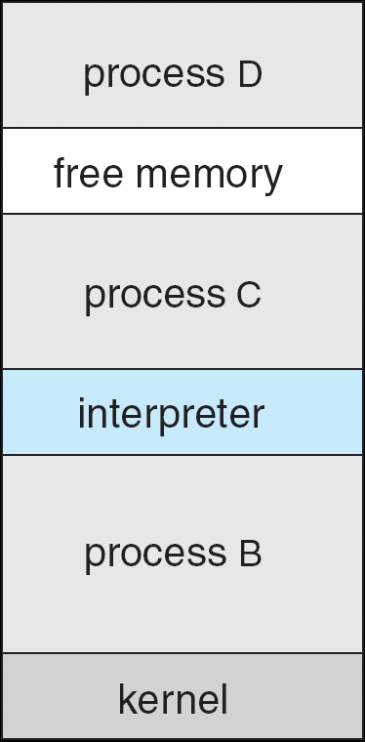
FreeBSD Running Multiple Programs

Slide 27
System Programs
System programs provide a convenient environment for program development and execution. They can be divided into:
File manipulation
Status information
File modification
Programming language support
Program loading and execution
Communications
Application programs
Most users’ view of the operation system is defined by system programs, not the actual system calls

Slide 28
System Programs
Provide a convenient environment for program development and execution
Some of them are simply user interfaces to system calls; others are considerably more complex
File management - Create, delete, copy, rename, print, dump, list, and generally manipulate files and directories
Status information
Some ask the system for info - date, time, amount of available memory, disk space, number of users
Others provide detailed performance, logging, and debugging information
Typically, these programs format and print the output to the terminal or other output devices
Some systems implement a registry - used to store and retrieve configuration information

Slide 29
System Programs (Cont.)
File modification
Text editors to create and modify files
Special commands to search contents of files or perform transformations of the text
Programming-language support - Compilers, assemblers, debuggers and interpreters sometimes provided
Program loading and execution- Absolute loaders, relocatable loaders, linkage editors, and overlay-loaders, debugging systems for higher-level and machine language
Communications - Provide the mechanism for creating virtual connections among processes, users, and computer systems
Allow users to send messages to one another’s screens, browse web pages, send electronic-mail messages, log in remotely, transfer files from one machine to another

Slide 30
Operating System Design and Implementation
Design and Implementation of OS not “solvable”, but some approaches have proven successful
Internal structure of different Operating Systems can vary widely
Start by defining goals and specifications
Affected by choice of hardware, type of system
User goals and System goals
User goals – operating system should be convenient to use, easy to learn, reliable, safe, and fast
System goals – operating system should be easy to design, implement, and maintain, as well as flexible, reliable, error-free, and efficient

Slide 31
Operating System Design and Implementation (Cont.)
Important principle to separate
Policy: What will be done? Mechanism: How to do it?
Mechanisms determine how to do something, policies decide what will be done
The separation of policy from mechanism is a very important principle, it allows maximum flexibility if policy decisions are to be changed later

Slide 32
Simple Structure
MS-DOS – written to provide the most functionality in the least space
Not divided into modules
Although MS-DOS has some structure, its interfaces and levels of functionality are not well separated

Slide 33
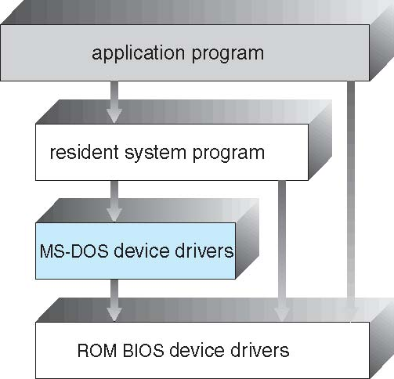
MS-DOS Layer Structure

Slide 34
Layered Approach
The operating system is divided into a number of layers (levels), each built on top of lower layers. The bottom layer (layer 0), is the hardware; the highest (layer N) is the user interface.
With modularity, layers are selected such that each uses functions (operations) and services of only lower-level layers

Slide 35
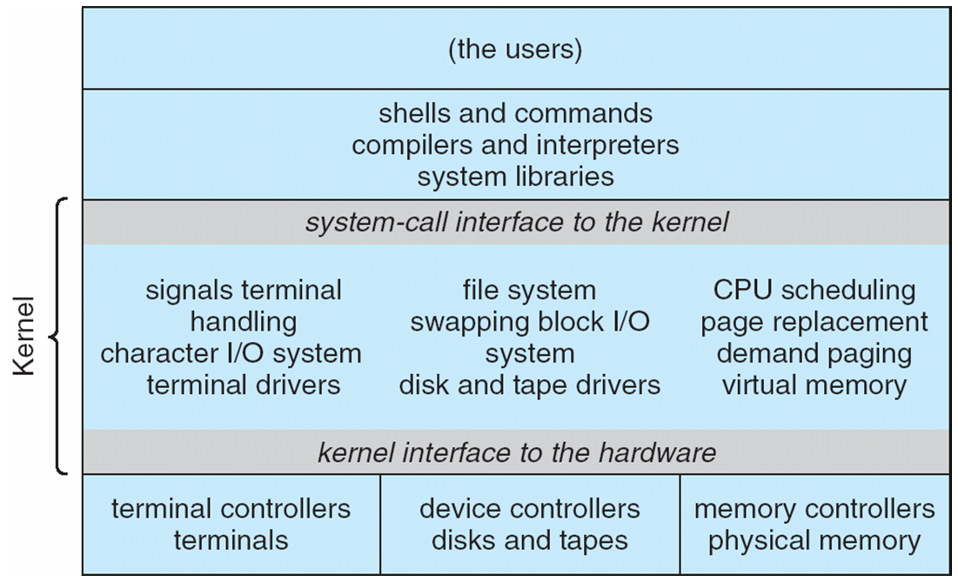
Traditional UNIX System Structure

Slide 36
UNIX
UNIX – limited by hardware functionality, the original UNIX operating system had limited structuring. The UNIX OS consists of two separable parts
Systems programs
The kernel
Consists of everything below the system-call interface and above the physical hardware
Provides the file system, CPU scheduling, memory management, and other operating-system functions; a large number of functions for one level

Slide 37
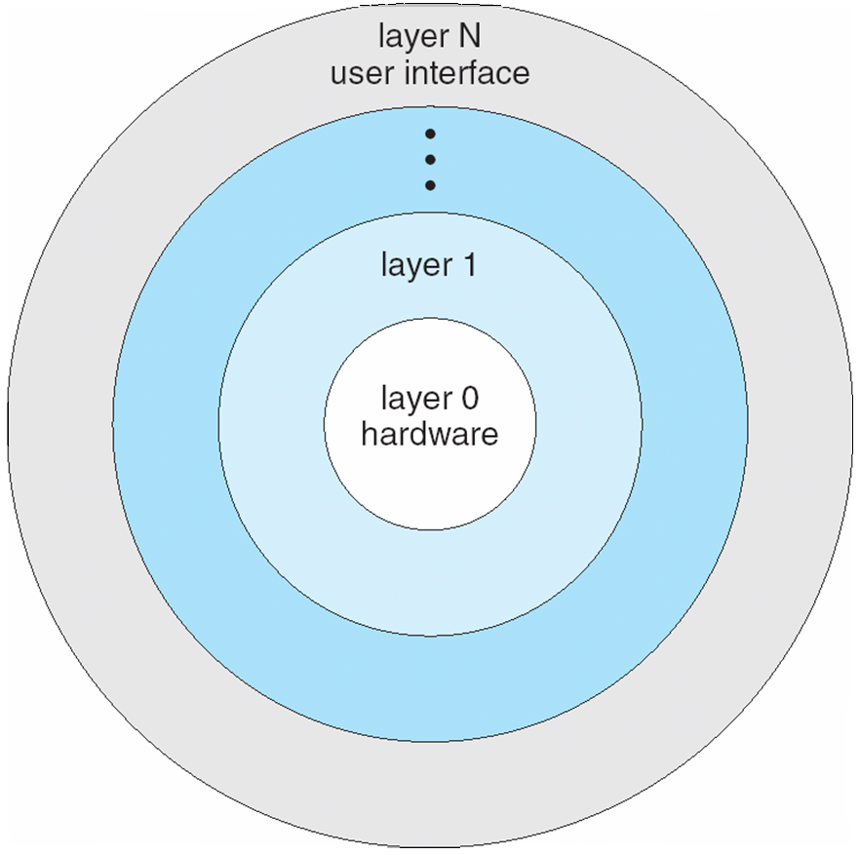
Layered Operating System

Slide 38
Microkernel System Structure
Moves as much from the kernel into “user” space
Communication takes place between user modules using message passing
Benefits:
Easier to extend a microkernel
Easier to port the operating system to new architectures
More reliable (less code is running in kernel mode)
More secure
Detriments:
Performance overhead of user space to kernel space communication

Slide 39
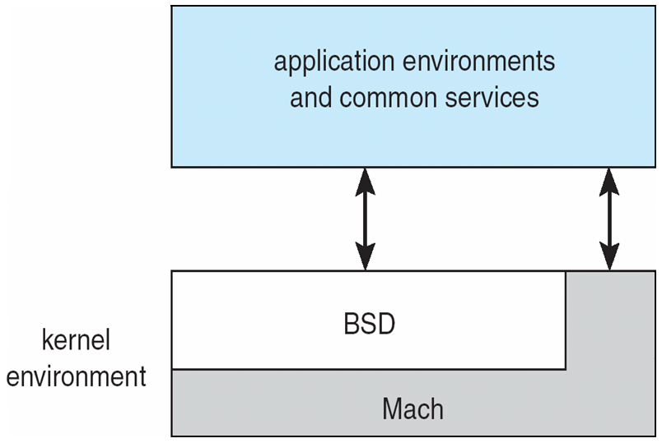
Mac OS X Structure

Slide 40
Modules
Most modern operating systems implement kernel modules
Uses object-oriented approach
Each core component is separate
Each talks to the others over known interfaces
Each is loadable as needed within the kernel
Overall, similar to layers but with more flexible

Slide 41
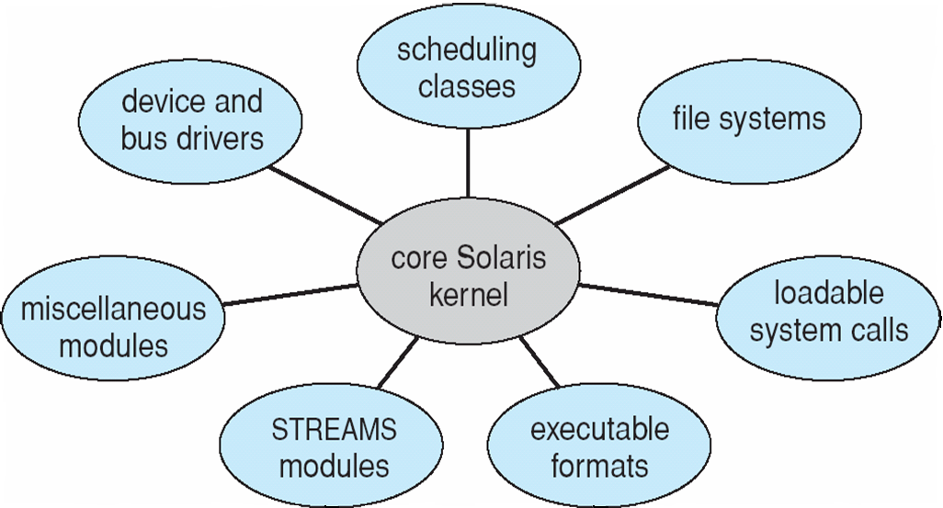
Solaris Modular Approach

Slide 42
Virtual Machines
A virtual machine takes the layered approach to its logical conclusion. It treats hardware and the operating system kernel as though they were all hardware.
A virtual machine provides an interface identical to the underlying bare hardware.
The operating system host creates the illusion that a process has its own processor and (virtual memory).
Each guest provided with a (virtual) copy of underlying computer.

Slide 43
Virtual Machines History and Benefits
First appeared commercially in IBM mainframes in 1972
Fundamentally, multiple execution environments (different operating systems) can share the same hardware
Protect from each other
Some sharing of file can be permitted, controlled
Commutate with each other, other physical systems via networking
Useful for development, testing
Consolidation of many low-resource use systems onto fewer busier systems
“Open Virtual Machine Format”, standard format of virtual machines, allows a VM to run within many different virtual machine (host) platforms

Slide 44
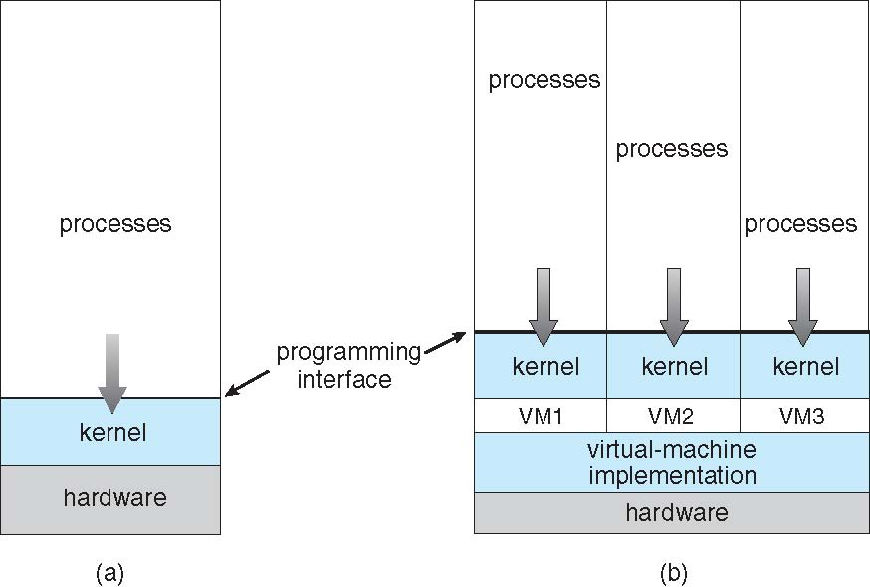
Virtual Machines (Cont.)
(a) Nonvirtual machine (b) virtual machine

Slide 45
Para-virtualization
Presents guest with system similar but not identical to hardware
Guest must be modified to run on paravirtualized hardware
Guest can be an OS, or in the case of Solaris 10 applications running in containers

Slide 46
Virtualization Implementation
Difficult to implement – must provide an exact duplicate of underlying machine
Typically runs in user mode, creates virtual user mode and virtual kernel mode
Timing can be an issue – slower than real machine
Hardware support needed
More support-> better virtualization
i.e. AMD provides “host” and “guest” modes

Slide 47
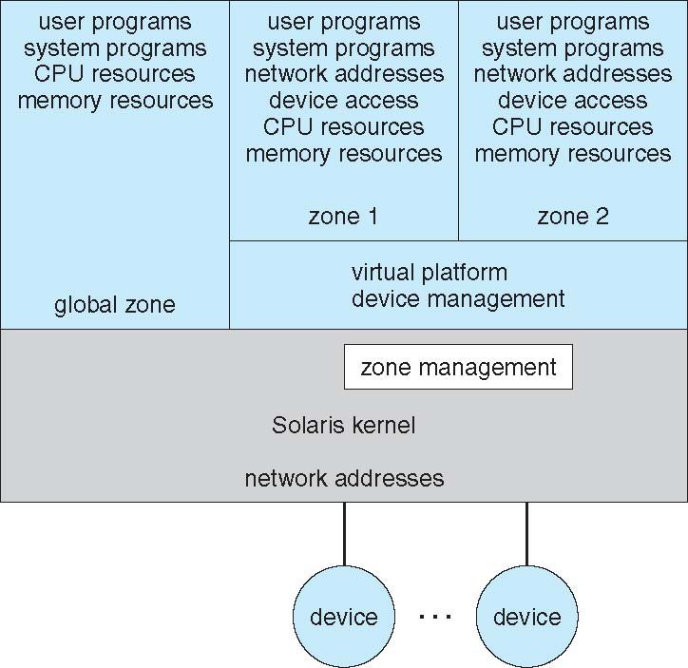
Solaris 10 with Two Containers

Slide 48
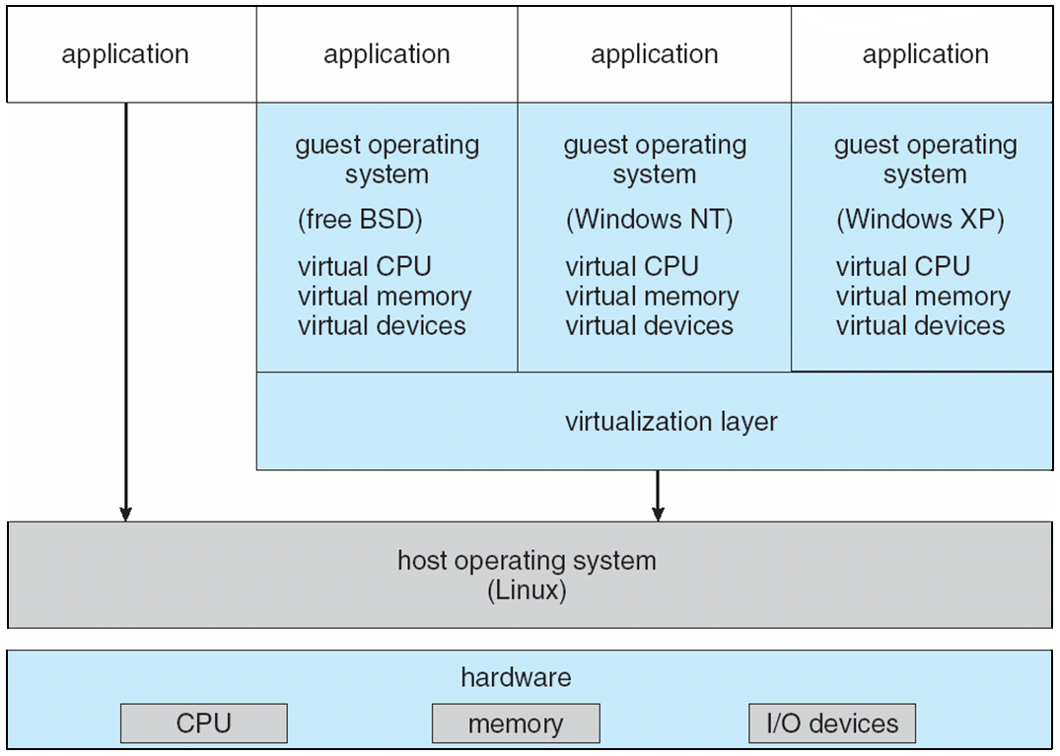
VMware Architecture

Slide 49
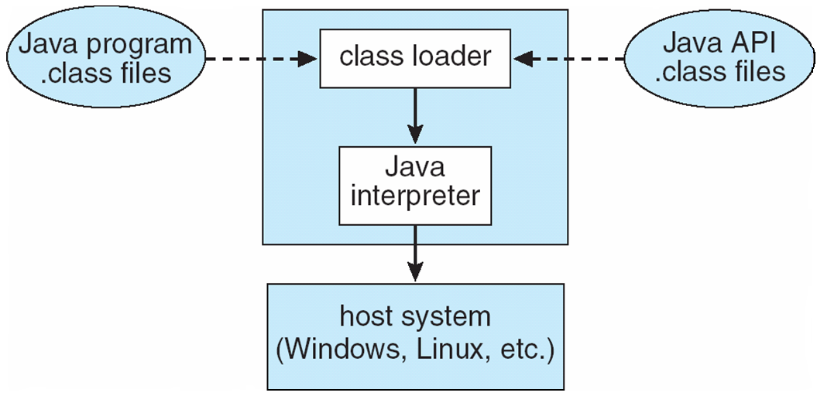
The Java Virtual Machine

Slide 50
Operating-System Debugging
Debugging is finding and fixing errors, or bugs
OSes generate log files containing error information
Failure of an application can generate core dump file capturing memory of the process
Operating system failure can generate crash dump file containing kernel memory
Beyond crashes, performance tuning can optimize system performance
Kernighan’s Law: “Debugging is twice as hard as writing the code in the first place. Therefore, if you write the code as cleverly as possible, you are, by definition, not smart enough to debug it.”
DTrace tool in Solaris, FreeBSD, Mac OS X allows live instrumentation on production systems
Probes fire when code is executed, capturing state data and sending it to consumers of those probes

Slide 51
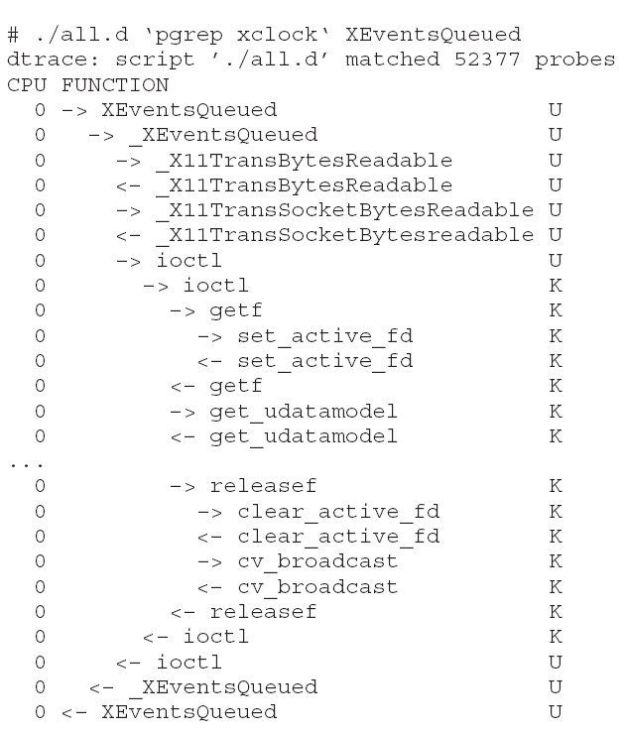
Solaris 10 dtrace Following System Call

Slide 52
Operating System Generation
Operating systems are designed to run on any of a class of machines; the system must be configured for each specific computer site
SYSGEN program obtains information concerning the specific configuration of the hardware system
Booting – starting a computer by loading the kernel
Bootstrap program – code stored in ROM that is able to locate the kernel, load it into memory, and start its execution

Slide 53
System Boot
Operating system must be made available to hardware so hardware can start it
Small piece of code – bootstrap loader, locates the kernel, loads it into memory, and starts it
Sometimes two-step process where boot block at fixed location loads bootstrap loader
When power initialized on system, execution starts at a fixed memory location
Firmware used to hold initial boot code

Slide 54
End of Chapter 2

